Slide 1
Amazon Product Reviews Sentiment Analysis
Presented By
Abhishek Lohra- 200243025002
Arvind Kumar Pandey -200243025008
Himanshu Shekhat -200243025015
Sanket Ashok Pujari 200243025046
Sonal Shende -200243025054

Slide 2
Objective
What are the most reviewed Amazon products?
What are the initial and current number of customer reviews for each product?
Map the keywords in the review text against the review ratings to help train sentiment models.

Slide 3
Introduction
Our project is Sentiment Analysis on Amazon Product.
where I am trying to Analysis customer provided reviews on all categories of the Products. We download data from the source using spark and perform required transformation like removing null values dropping unnecessary data and load that data into Mongodb
For further analysis for faster data retrieval from Mongodb we use text indexer on review column.
We consider this Mongodb as a source and try to perform segmentation using algorithm like knn ,adaboost, multinomial

Slide 4
Tools Required
Tools Required
Language Used
Data Engineering : Spark , MongoDB
Data Analysis : Pandas
Data Visualization: Tableau desktop
Python
PySpark
NoSql :MongoDB

Slide 5
Flow Chart
Raw Data
Extracting data
Tranformation
Load data
MongoDB
Spark
spark
Goal
Reporting
Uploading data
Analysis
Tableau
MongoDB
Anaconda

Slide 6
Steps followed
Step 1: Load data
Step 2: Balance the data sheet (Count the values)
Step 3: Cleaning the data
Step 4: Split dataset into train ,validation and test.
Step 5: Apply the algorithm for the process

Slide 7
Dataset Reference & Variables
https://www.kaggle.com/datafiniti/consumer-reviews-of-amazon-products
Name - name
Brand -brand
Categories – categories
Reviews Date- reviews.date
Reviews Rating -reviews.rating
Reviews Text - reviews.text

Slide 8
Data Wrangling
Removed empty lines
Filling NA values with imputed mean for some (int) features
Dropping outliers
Adding New features Based on the requirement
Merging all the Dataframes
Storing the data into database

Slide 9
Algorithms used
Random Forest : Random Forests are an ensemble learning method that is for performing classification, regression as well as other tasks through the construction of decision trees and providing the output as a class which is the mode or mean of the underlying individual trees.
Random forest has nearly the same hyperparameters as a decision tree or a bagging classifier. ... Random forest adds additional randomness to the model, while growing the trees. Instead of searching for the most important feature while splitting a node, it searches for the best feature among a random subset of features.

Slide 10
Cont…
Adaboost : AdaBoost is best used to boost the performance of decision trees on binary classification problems. AdaBoost was originally called AdaBoost. M1 by the authors of the technique Freund and Schapire. More recently it may be referred to as discrete AdaBoost because it is used for classification rather than regression.
AdaBoost, short for Adaptive Boosting, is a machine learning meta-algorithm formulated by Yoav Freund and Robert Schapire, who won the 2003 Gödel Prize for their work. It can be used in conjunction with many other types of learning algorithms to improve performance. The output of the other learning algorithms ('weak learners') is combined into a weighted sum that represents the final output of the boosted classifier. AdaBoost is adaptive in the sense that subsequent weak learners are tweaked in favor of those instances misclassified by previous classifiers. In some problems it can be less susceptible to the overfitting problem than other learning algorithms.

Slide 11
Cont..
Multinomial Naïve Bayes :
The multinomial Naive Bayes classifier is suitable for classification with discrete features (e.g., word counts for text classification). The multinomial distribution normally requires integer feature counts. However, in practice, fractional counts such as tf-idf may also work.
Multinomial Naïve Bayes uses term frequency i.e. the number of times a given term appears in a document. After normalization, term frequency can be used to compute maximum likelihood estimates based on the training data to estimate the conditional probability.

Slide 12
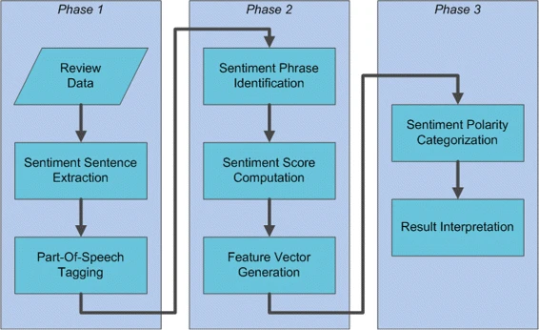

Slide 13
Thank You..!

